Slide 1
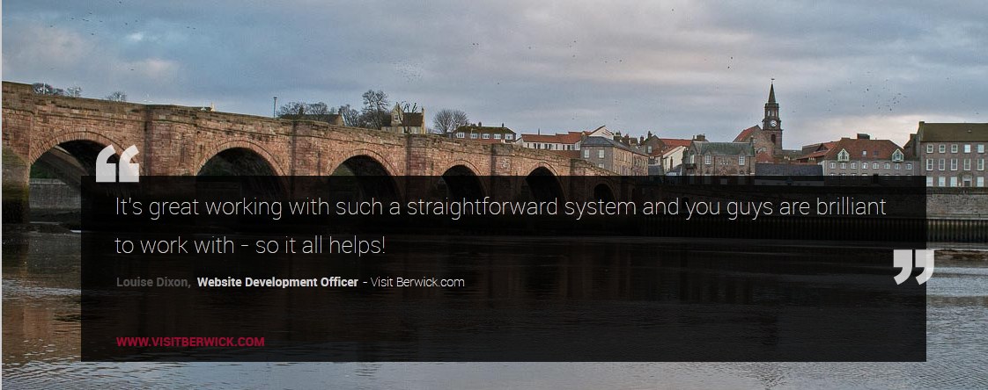
NTADs

Slide 2
What is NTADs?
Easy to use interface where client can create and amend their own web entries on the DMOs site
Client can amend/update their entry at any time – allowing great flexibility. E.g. Client can add special offers, change prices, alter photographs (Perhaps adding a seasonal photograph)
Real time updates – as soon as the client updates their web entry it refreshes live on the website immediately
Real time stats - client can see how well their web entry is performing: can see the number of people that have viewed their advert, gone through to their website, emailed them and the number of times the advert has been displayed 1st, 2nd or 3rd in searches
Social Media links – can link to client’s facebook and twitter pages
Labour Saving – Client creates the majority of their advert and is responsible for amends, therefore less labour intensive for DMO than other systems

Slide 3
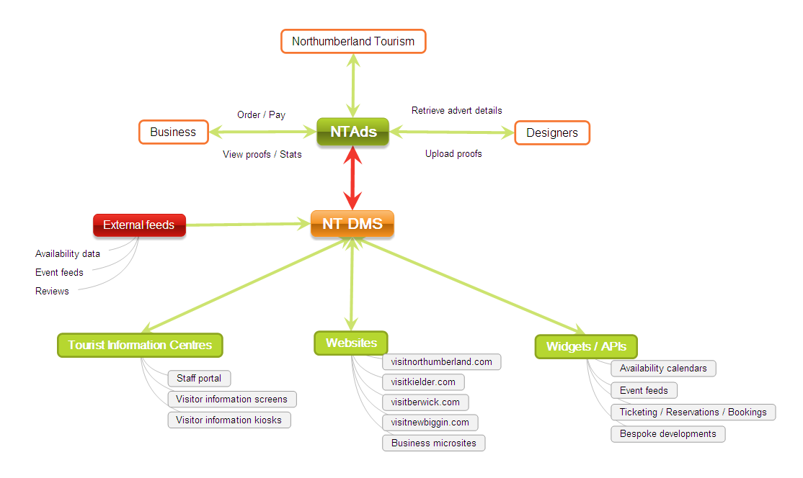
How Does it all Link?

Slide 4
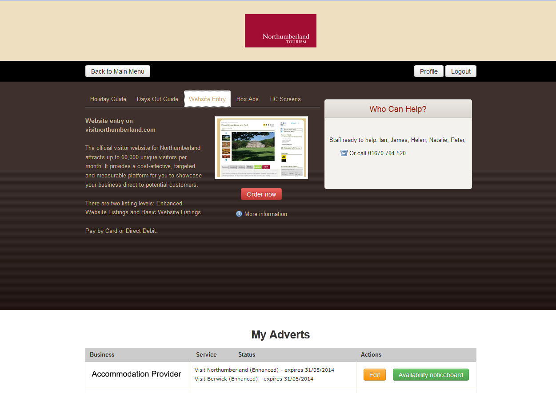
NTADs Log In Screen
Tabs to select the product they would like to order. This can be tailored to DMOs requirements for print and online sales
List of adverts booked
To create or make changes to their web entry
Clear, easy to follow welcome screen.
Easy navigation, even for those who may not be 100% computer literate.

Slide 5
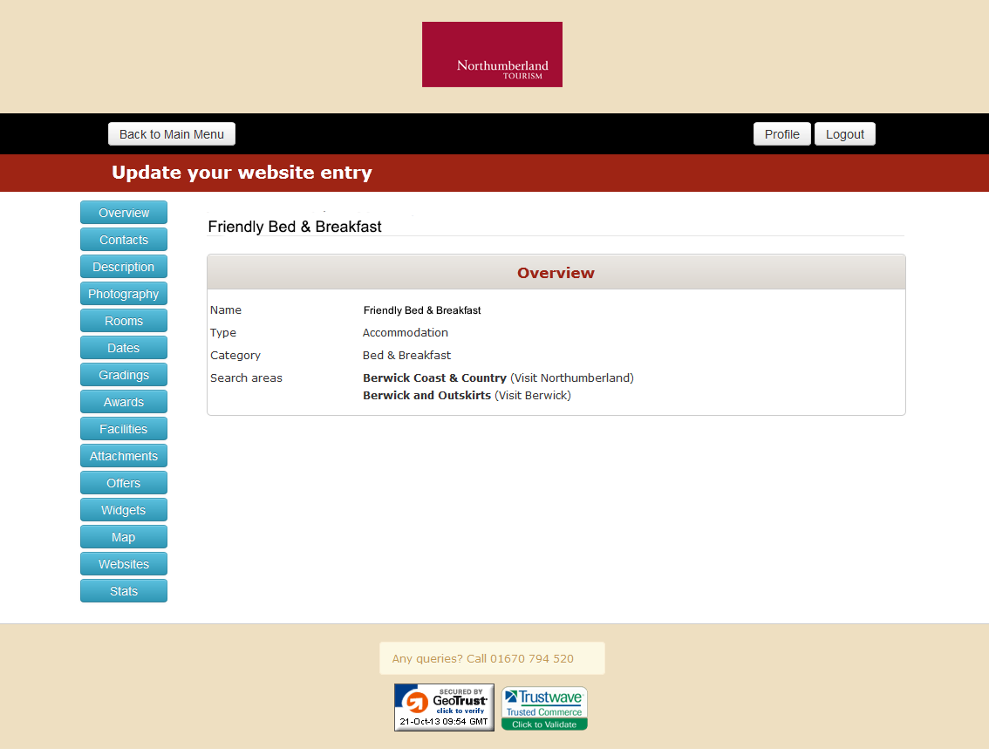
Overview Screen
Type – e.g. Accommodation, attraction, food & drink, shopping... The categories can be tailored to the requirements of the DMO
Navigation buttons (Blue) used to enter/amend information.
Clear and easy to follow for the client

Slide 6
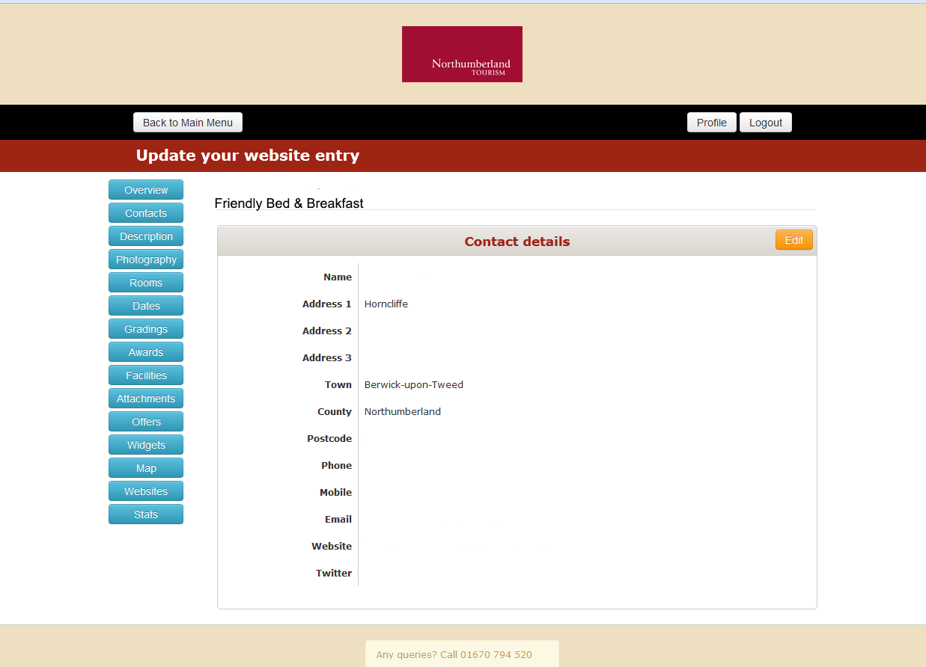
Contact Details
Contact Details as will be displayed on their web entry
Website: Creates a ‘button’ on the website which takes the viewer directly to the businesses website
Email: ‘Button’ so viewer can email the business directly
Twitter: Adds the client’s twitter feed to their web entry

Slide 7
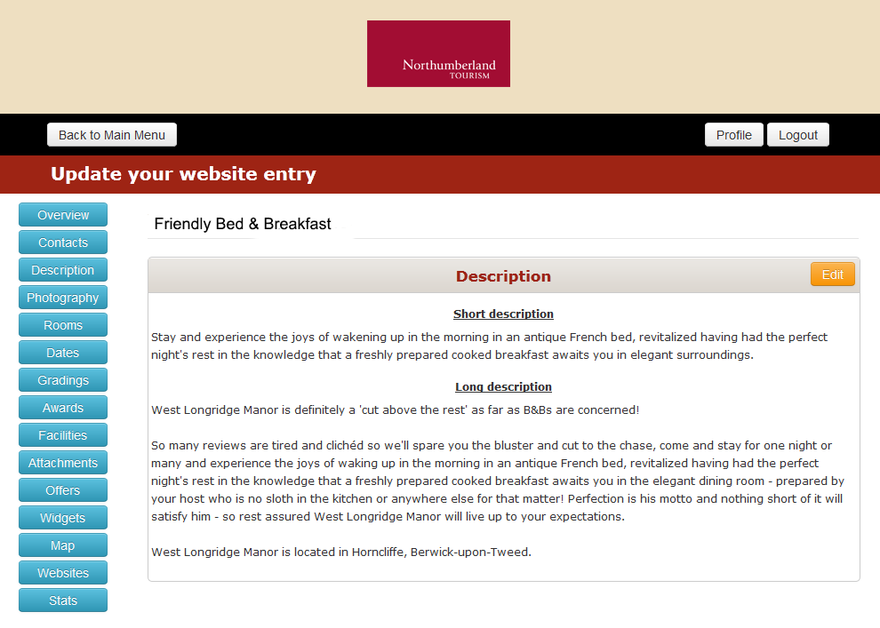
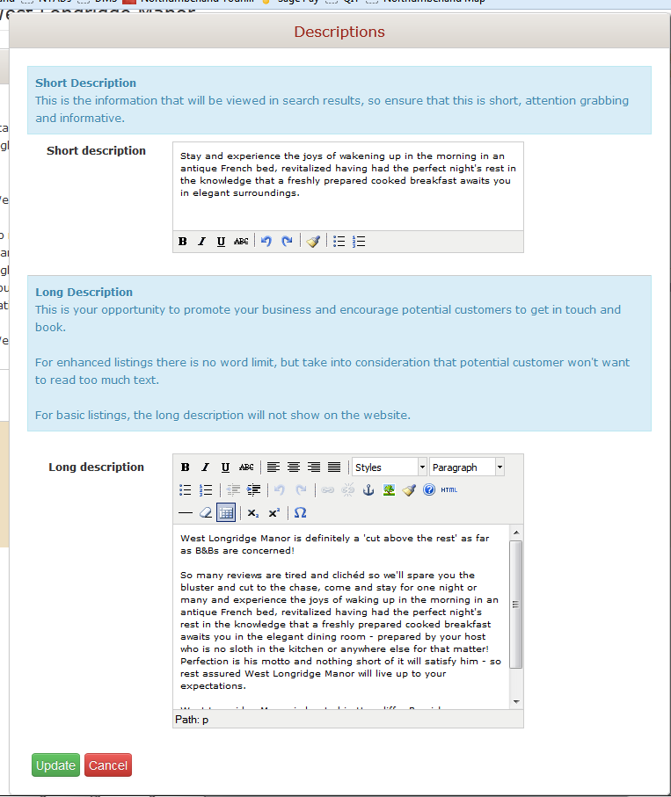
Description
Shows the current description . When the user clicks on edit they are taken to the screen where they can edit (Bottom)
Explains where the two descriptions will be used. The information in the blue boxes can be tailored to the DMO’s requirements
User makes changes in the same way as using many Word Processing Programmes and then clicks ‘Update’ when changes made. As soon as this is done, the changes will be live on the website

Slide 8
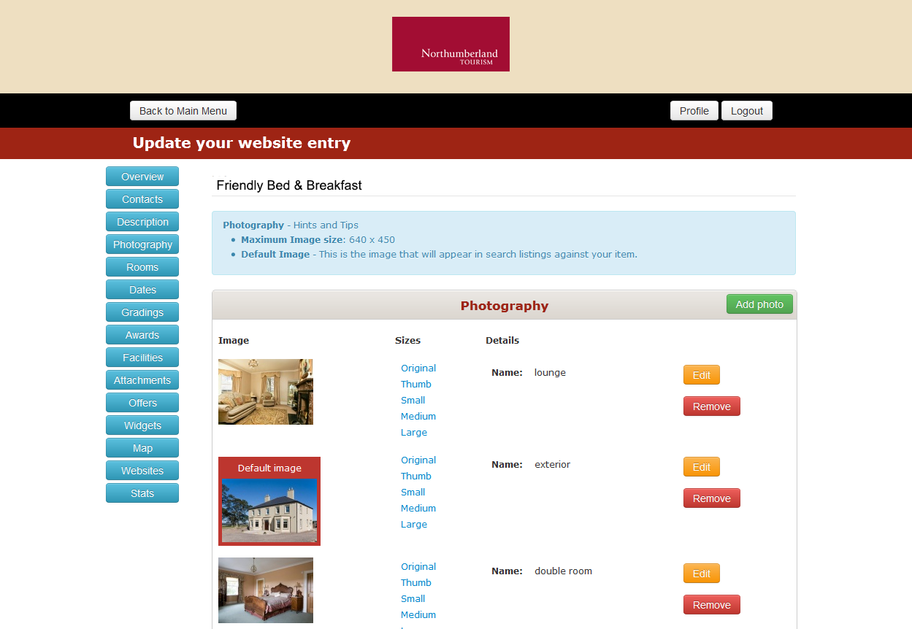
Photography
Very easy for client to upload photographs
Client selects which image to have as their default image

Slide 9
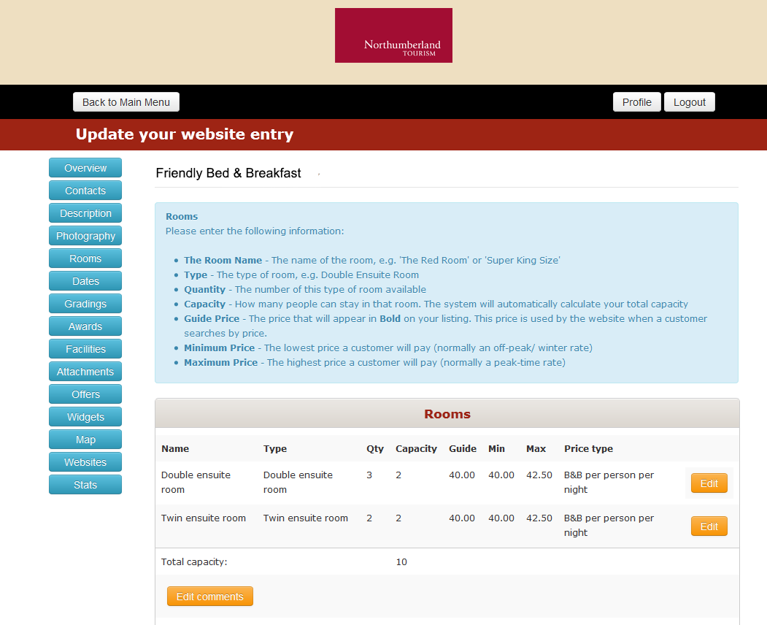
Rooms
Users can amend their prices including Guide price (Shown in bold) and minimum and maximum prices and capacity of each room.
Clear layout, so client has to fill in all required information

Slide 10
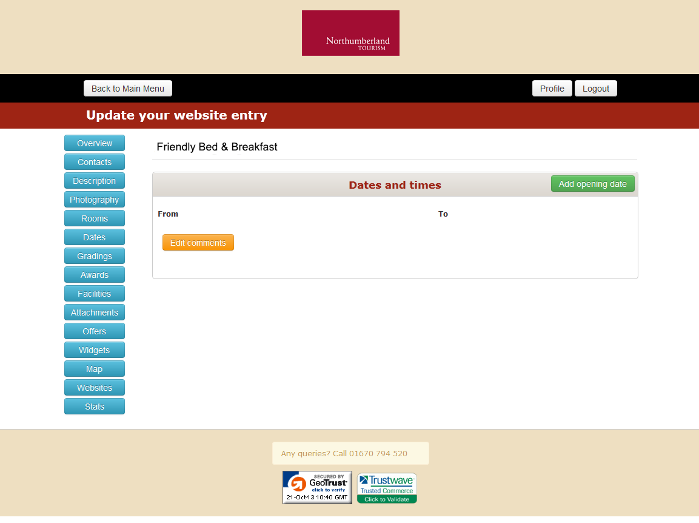
Dates
Dates – used for opening and closing times of attractions or shops

Slide 11
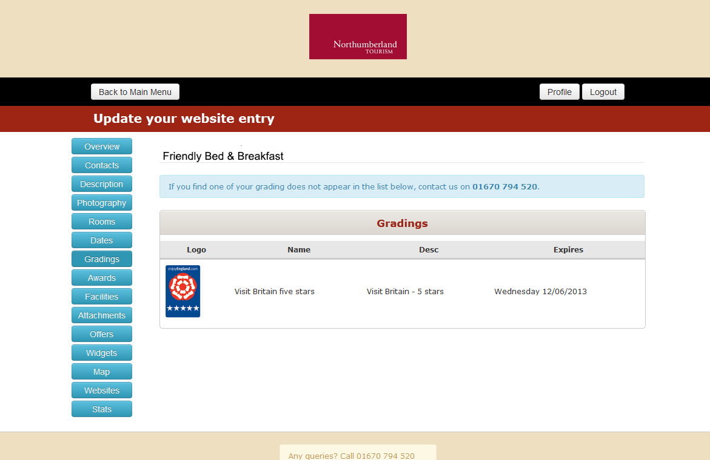
Grading
User has to contact DMO to add/amend grading.
Measure to ensure individual businesses can’t add a grading they don’t have.
Very simple process, selecting relevant grading from a drop down box and entering expiry date

Slide 12
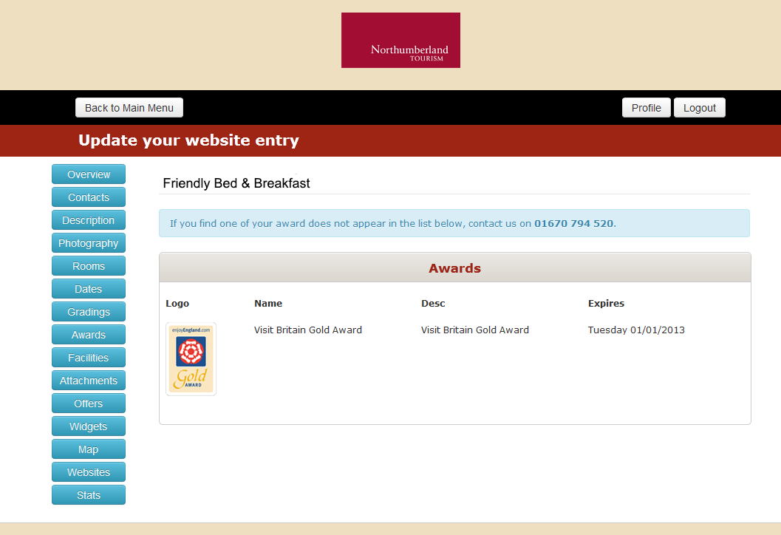
Awards
User has to contact DMO to add/amend award. Measure to ensure individual businesses can’t add an award they don’t have.
Very simple process, selecting relevant grading from a drop down box and entering expiry date

Slide 13
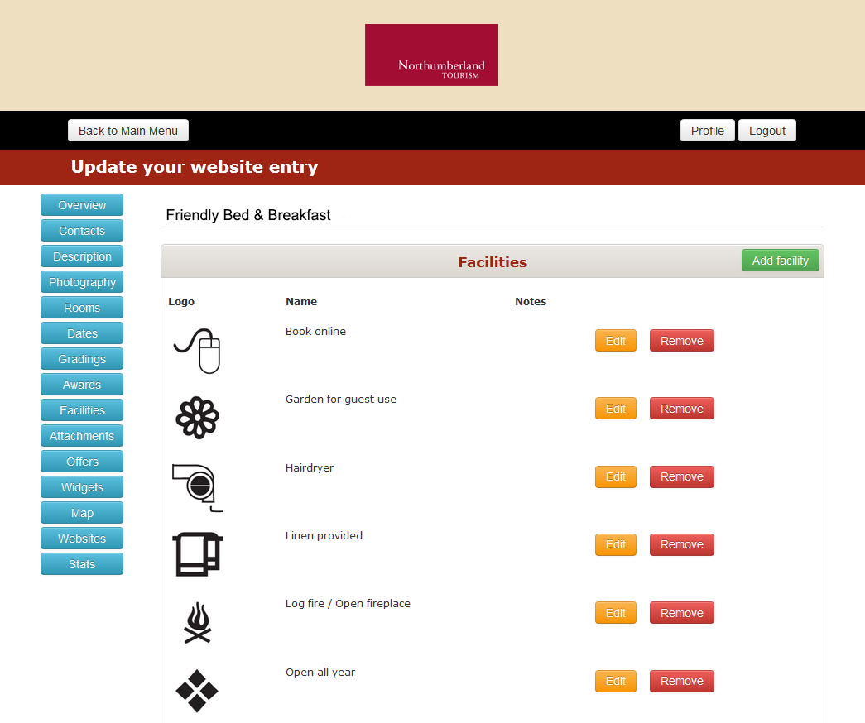
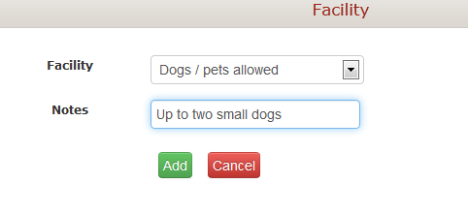
Facilities
User selects any relevant facility
symbols for their property.
These are from a drop down box so the DMO controls the facility symbols that can be selected.
User can add a short note to the symbol. E.g. Number of pets allowed
Very straightforward using drop down boxes to select appropriate facility symbols

Slide 14
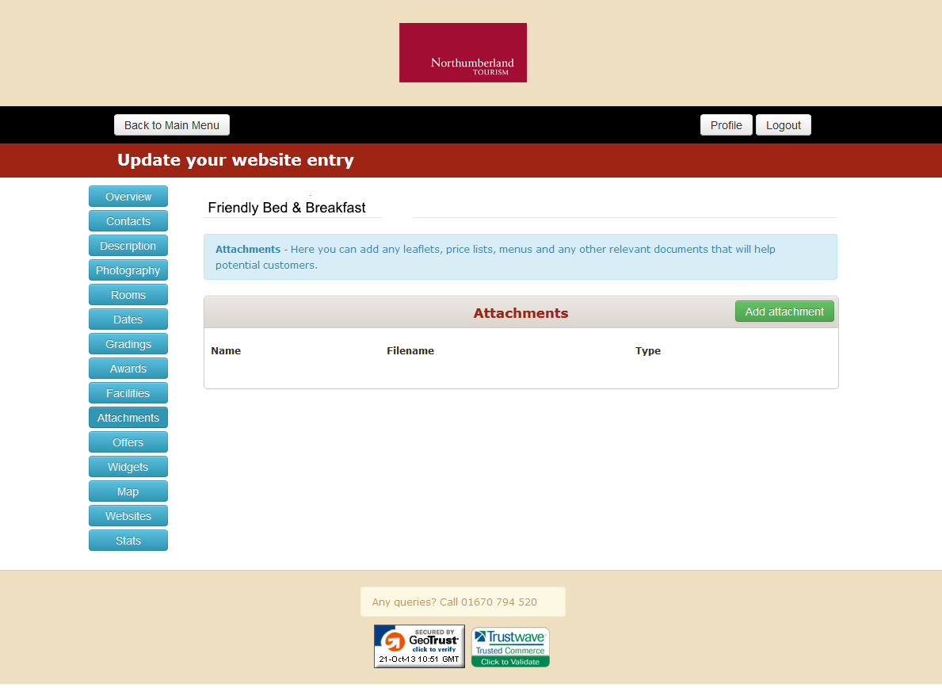
Attachments
Facility to add an attachment. E.g. Breakfast menu or price list
Great flexibility, to add relevant information to enhance the clients listing

Slide 15
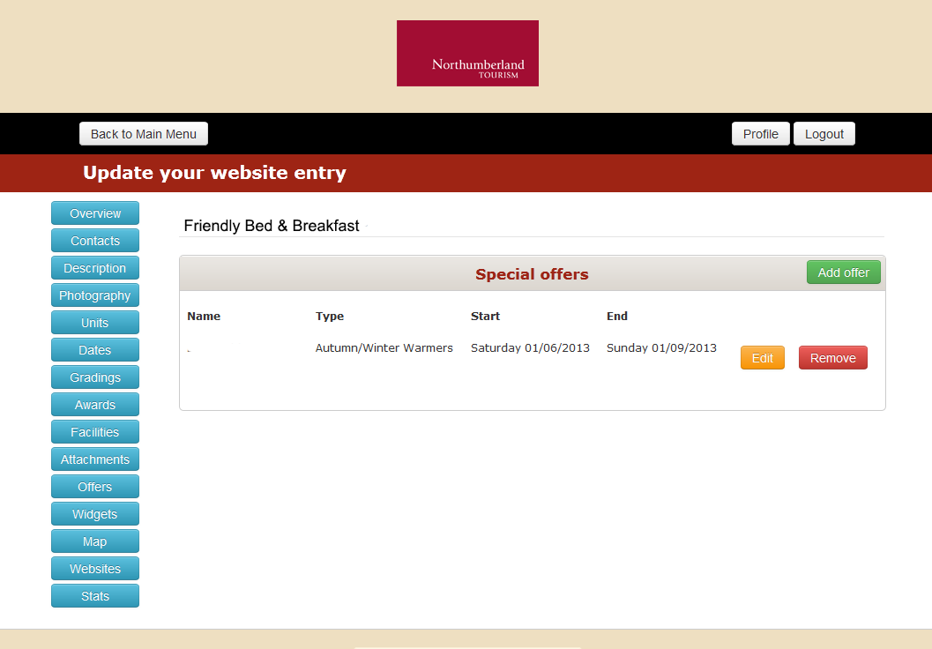
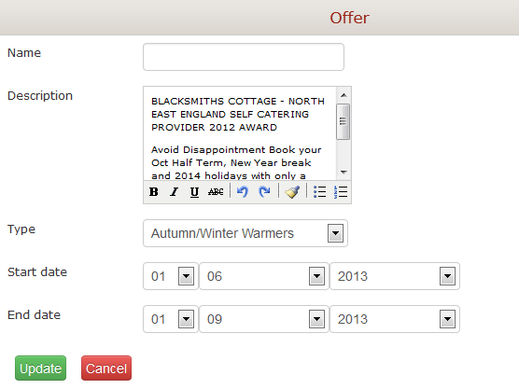
Offers
DMO can create set ‘offers’ e.g. ‘3 for 2’, ‘ Autumn/Winter Warmers’
Client then adds in their own offer with a description of the offer, including start and end dates
Offer will be automatically removed by the system on the end date
Simple and straight forward to use. Emphasis on client to add their own offers.

Slide 16
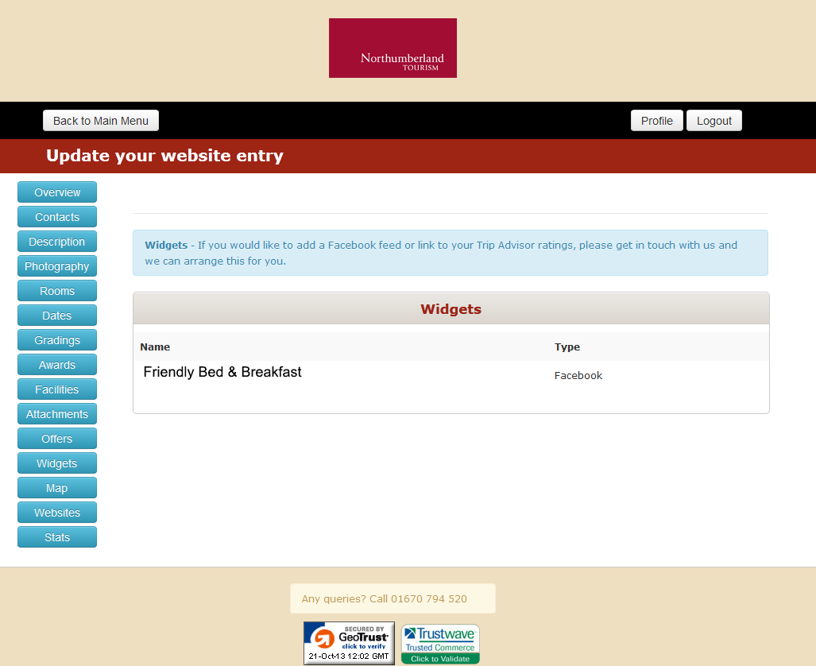
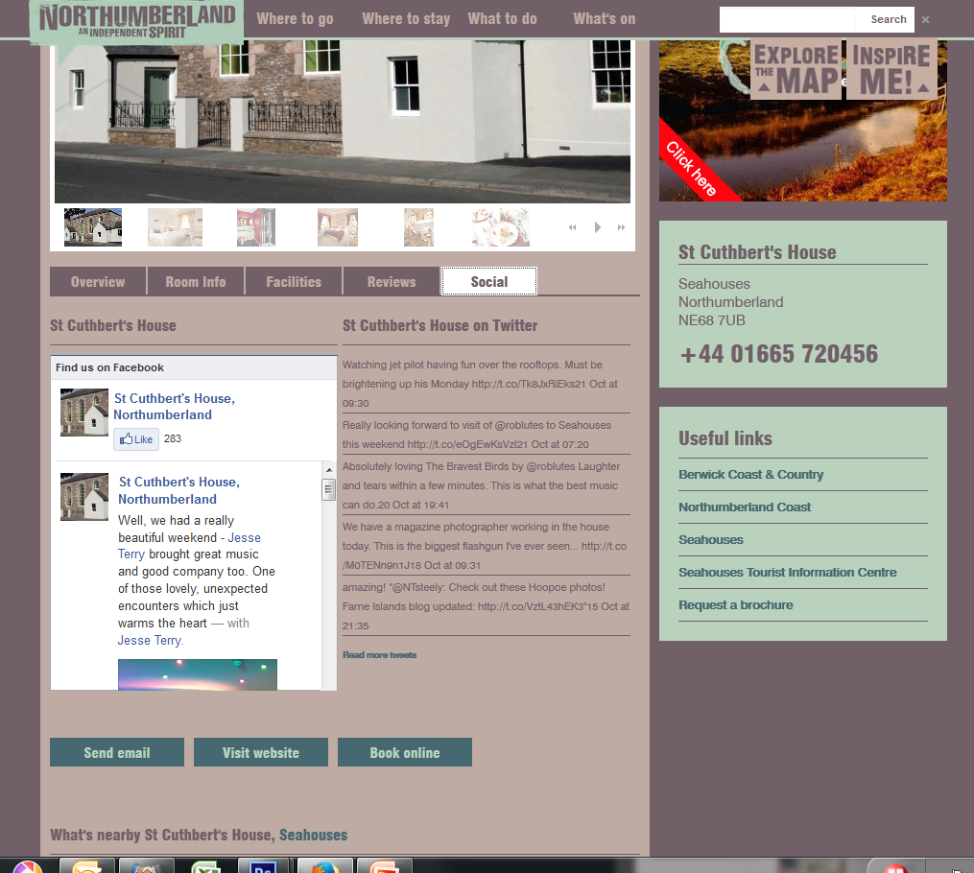
Widgets
Easy for DMO to add on a facebook link or Trip Advisor (Assuming DMO has a link with Trip Advisor).
Can also add ‘Book online’ button from here – taking directly to clients own booking page.
Links can be developed with booking agents so that availability can be displayed on the web entry

Slide 17
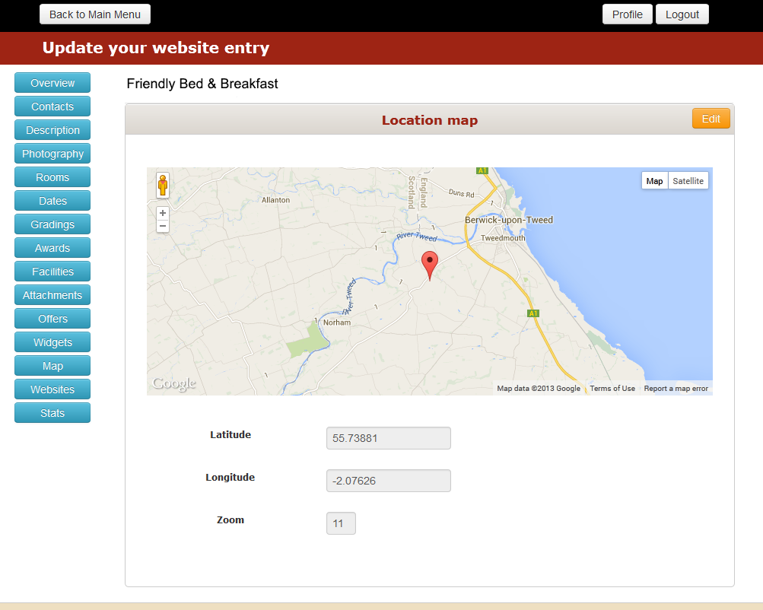
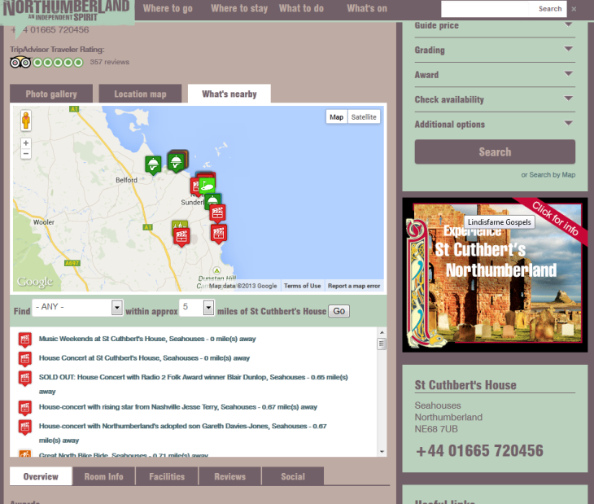
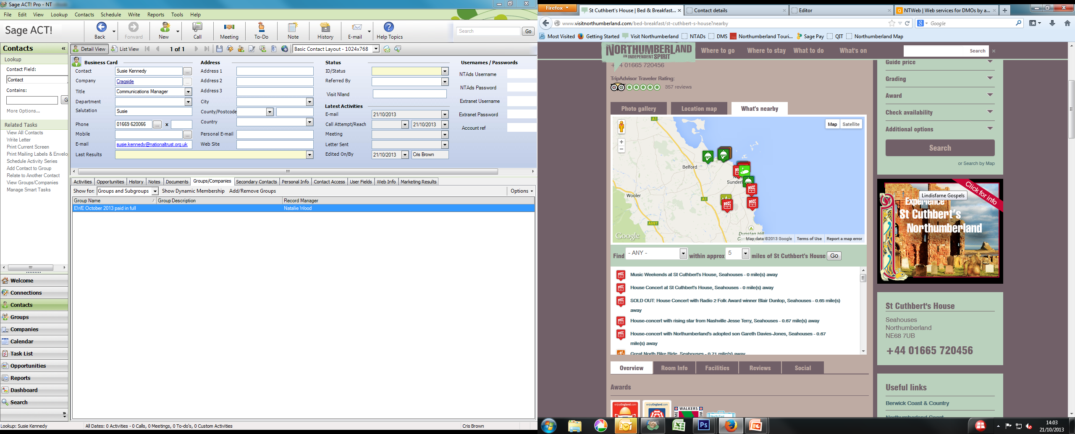
Map
User can enter exact longitude and latitude to ensure the map is accurate.
This information can be found using:
http://www.itouchmap.com/latlong.html
From this information the system will automatically calculate and display ‘what is nearby’

Slide 18
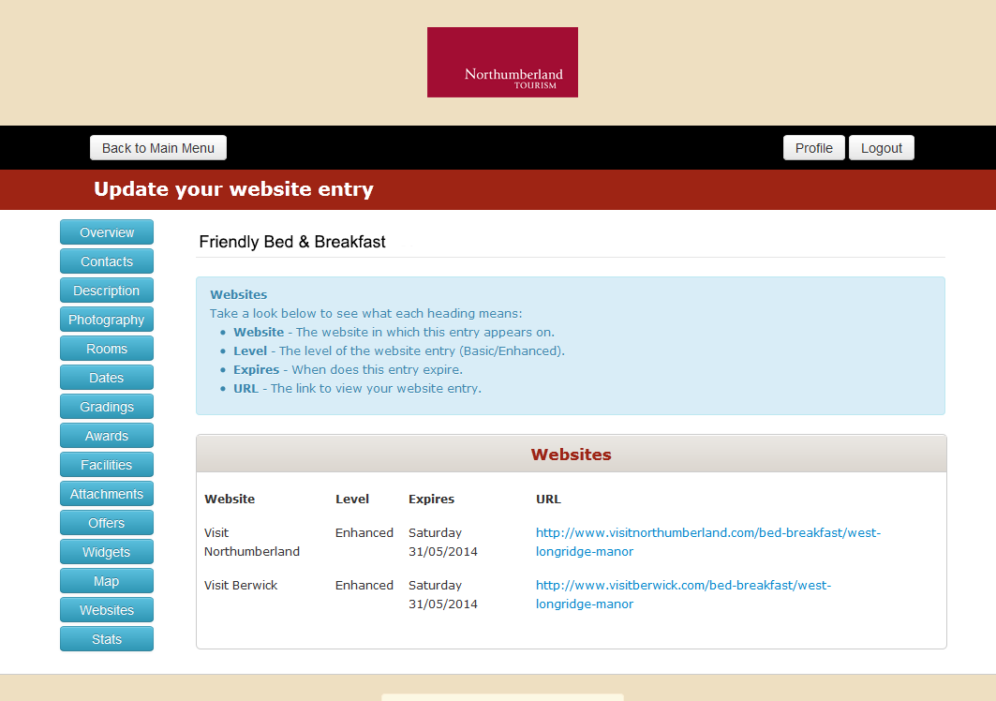
Websites
If a DMO has multiple websites, ability to add the entry to both.
Client can click on the URL and will be taken directly to their web entry
Can clearly see when the entry is due for renewal

Slide 19
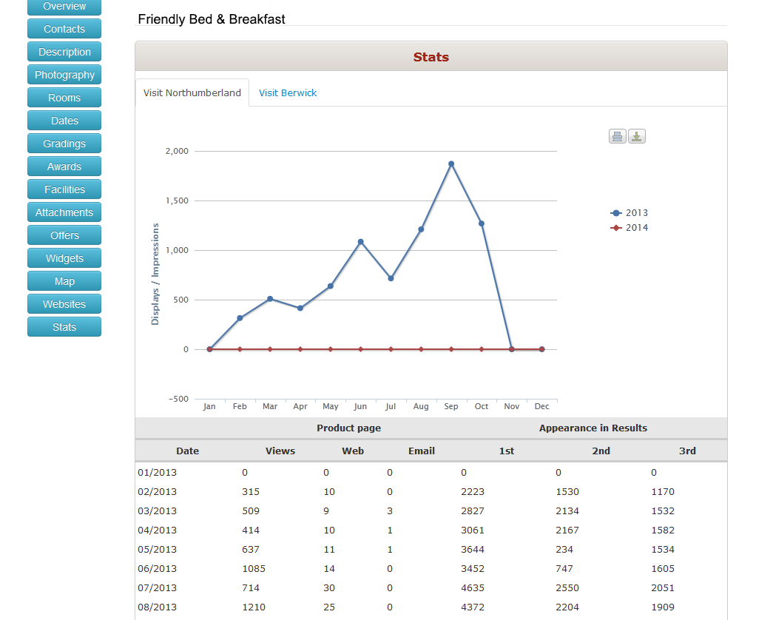
Stats
Real time stats for the web entry:
Views: Number of times the entry has been viewed (Clicked on)
Web: Number of times the ‘website’ button has been clicked (Takes the viewer directly to the providers own website)
Email: no of times the person has been sent an email directly from the web entry
Appearance in results – number of times the advert has been displayed 1st, 2nd and 3rd when a viewer does a search

